Slide 1
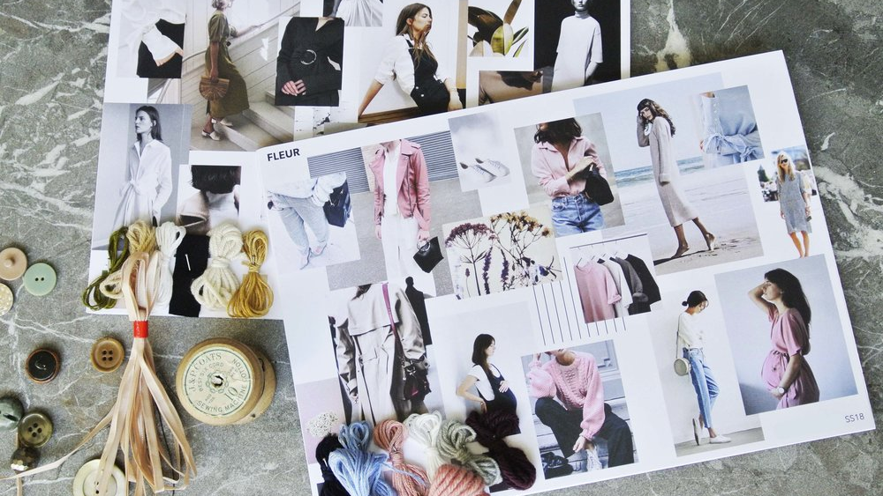
Creating a mood board

Slide 2
Finding Inspiration
Your mood board can be physical or digital
Before you create your mood board you need to decide on a theme.​
Your theme can be anything you want it to be as long as it involves colour.​
Look at magazines, books, TV, films, music videos. Maybe you have a favourite picture, painting or place. Is there a material you would like to use?​
ANYTHING that inspires you can be used for your mood board.​

Slide 3
Choosing a theme Previous themes and suggestions for your image
Avant Garde – experimental, pushing the ‘normal’ boundaries
Catwalk/fashion

Slide 4
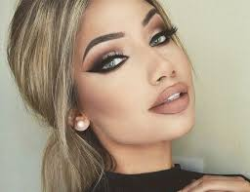
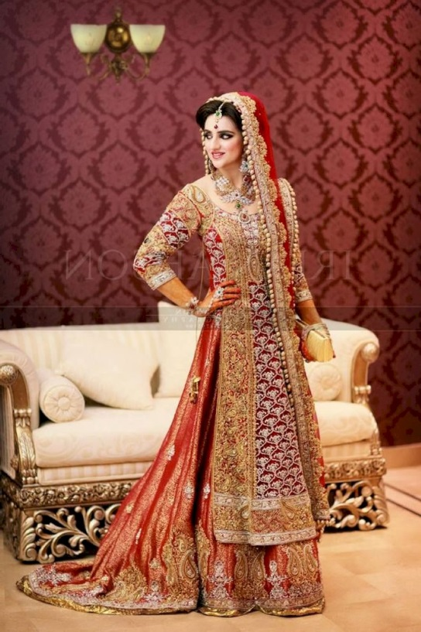
Wedding
School prom

Slide 5
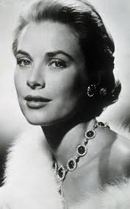
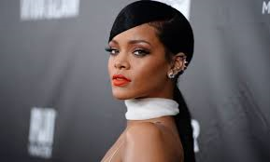
Historical ideas
Famous people
Grace Kelly – American actress
Helena Rubenstien – make up entrepreneur

Slide 6
Disney© characters
Futuristic

Slide 7
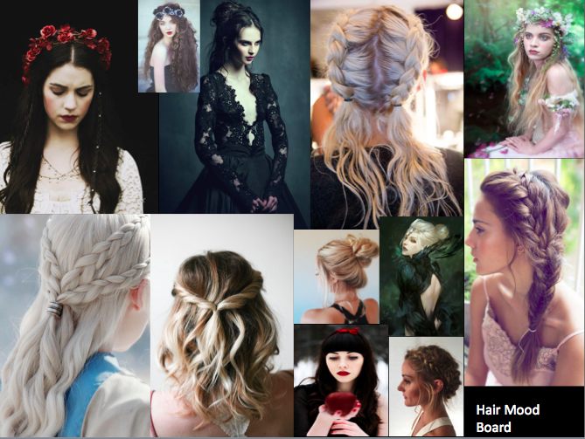
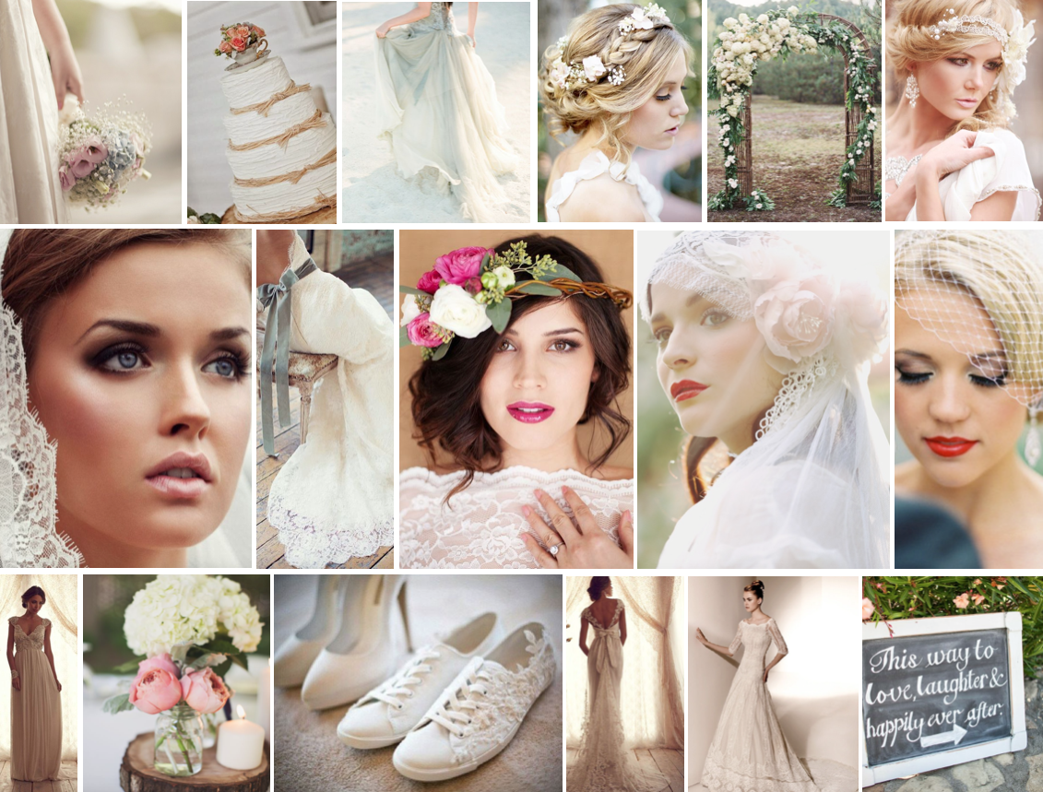
Examples

Slide 8
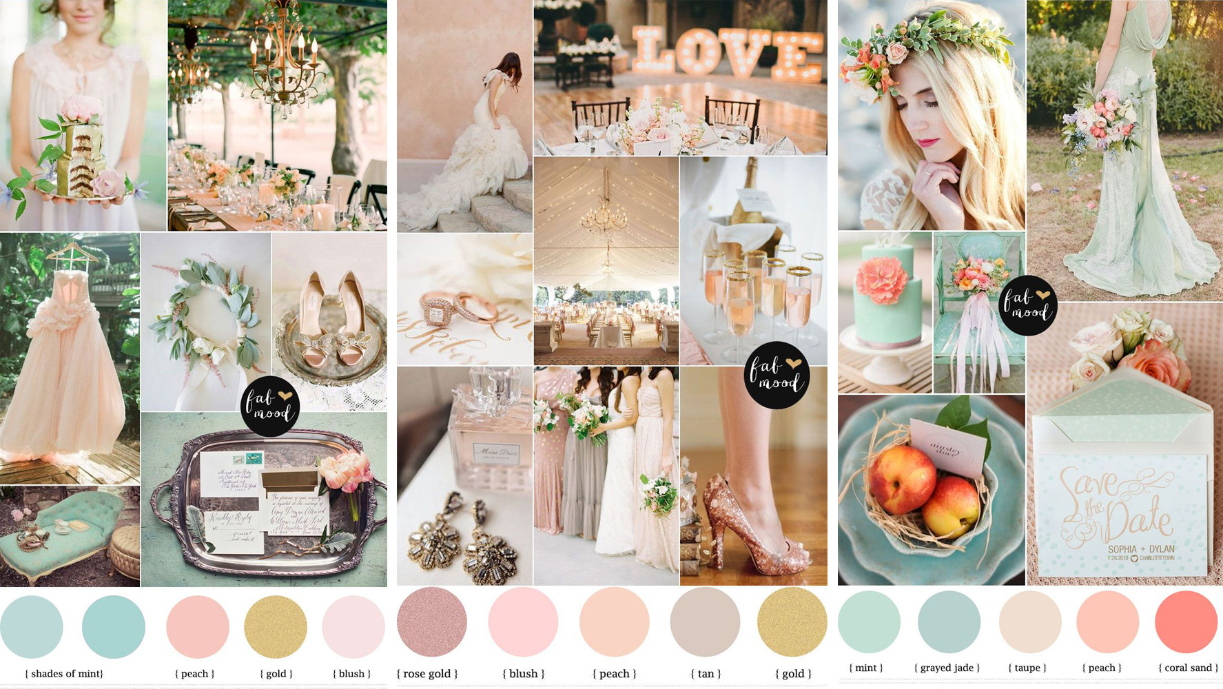
Examples

Slide 9
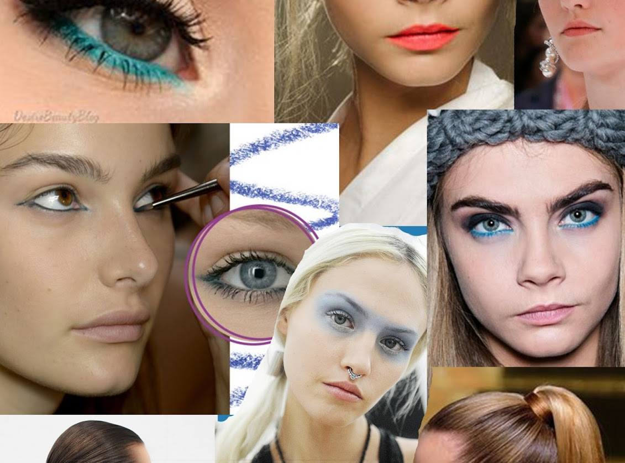
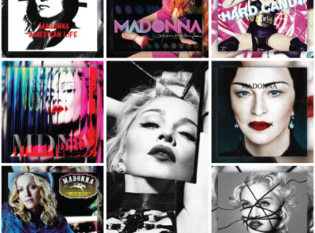
Examples

Slide 10
Other eye-catching suggestions to inspire you
Plants
Fantasy animals
Seasonal events
Holidays
Carry out research
Internet
Magazines
Trade magazines
Books
Include images with hair, makeup and nails

Slide 11
Mood board
What is a mood board ?
A vivid description or representation of an overall look. A mood board is described as a visual aid used to share thoughts, influences and concepts for a project. It is a pictorial point of reference. It is used to refer to during the creation of your total look to help with the continuity and consistency
Physically what does it look like
This is an arrangement of images, materials, pieces of text etc. intended to provide an overall feel or flow to illustrate the ideas relating to your theme and document your research and influences

